Slide 1
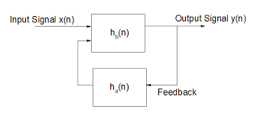
IIR Filter Project Overview
Prepared By: Max Destil | Advanced VLSI Design- ECSE 6680 | 04/22/24

Slide 2
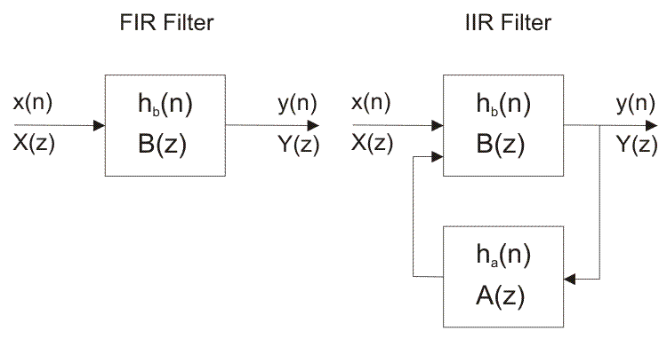
Project Scope and Objective
Introduction of design of a low-pass IIR filter in MATLAB to meet specific frequency response characteristics, mirroring existing FIR filter performance
Address the design and implementation complexities by contrasting the direct calculation approach of the IIR filter with the iterative method of the FIR filter
Emphasize the unique challenges such as the recursive nature, stability, and quantization effects inherent to the IIR filter design process
Figure 1: FIR vs. IIR

Slide 3
FIR vs. IIR Design Challenges
Executed a transition from the iterative optimization process of FIR design to a calculated, formulaic approach in IIR filter order determination to match stringent frequency response criteria
Addressed the recursive algorithmic challenges of IIR filter design, with a concentrated focus on stability and the implications of coefficient quantization to assure system reliability
Analyzed and synthesized the theoretical and practical nuances of IIR filter complexities, applying advanced DSP principles to achieve the target specifications

Slide 4
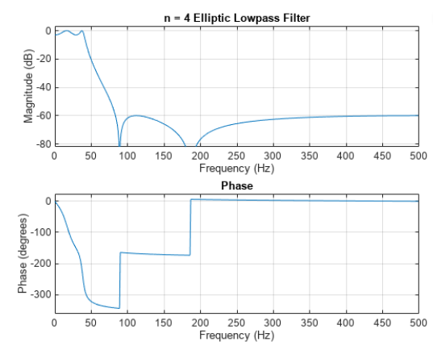
MATLAB Design Process
Utilized MATLAB's ellipord function for precision specification of the low-pass IIR filter, ensuring stringent adherence to frequency response goals
Executed elliptic filter design using the ellip function to achieve a sharply defined rolloff characteristic with a computationally efficient filter order
Synthesized the IIR filter algorithm to balance the minimization of passband ripple against stringent stopband attenuation requirements
Figure 2: Example from MATLAB documentation

Slide 5
Transition to Hardware Design
Verilog implementation, translating MATLAB-designed IIR filter into synthesizable RTL code, adhering to specified frequency characteristics
Advanced pipelining to enhance data flow efficiency, reduce computational latency, and ensure high throughput in real-time processing
Deployed parallel processing techniques, enabling concurrent computation and boosting system performance within the hardware constraints

Slide 6
Ensuring Filter Stability
Developed feedback mechanism, integrating saturation arithmetic to prevent numerical overflow
Prioritized the establishment of initial conditions and meticulously managed feedback for system stability
Implemented robust stability controls to safeguard against potential recursive feedback instabilities
Enforced precision regulation through COEFFICIENT_WIDTH parameters to ensure consistent performance and filter output integrity
Figure 3: IIR Feedback

Slide 7
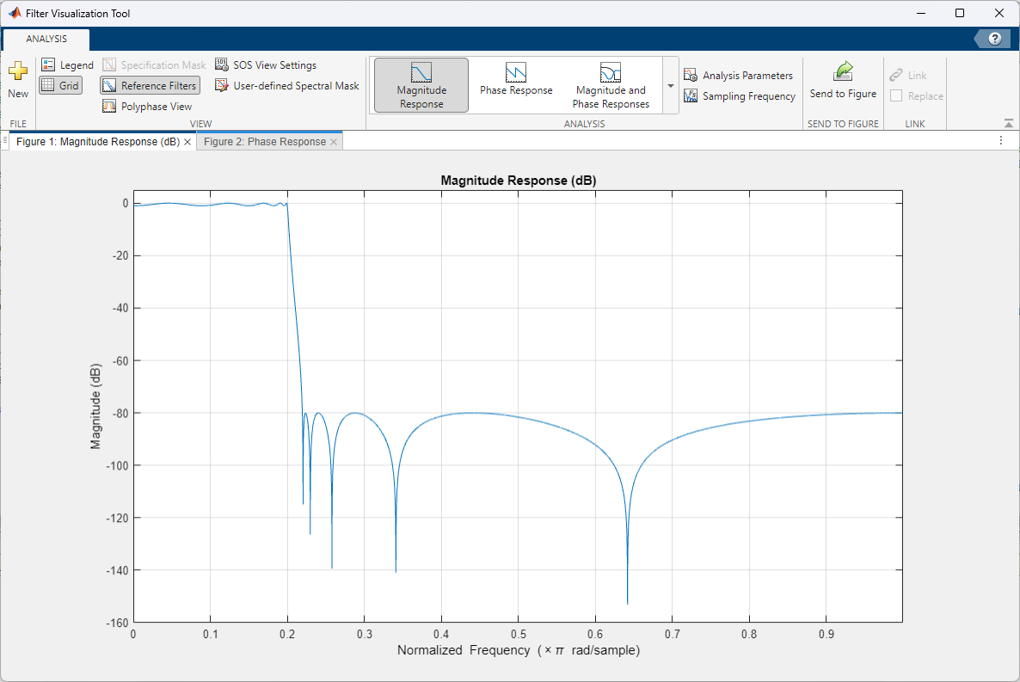
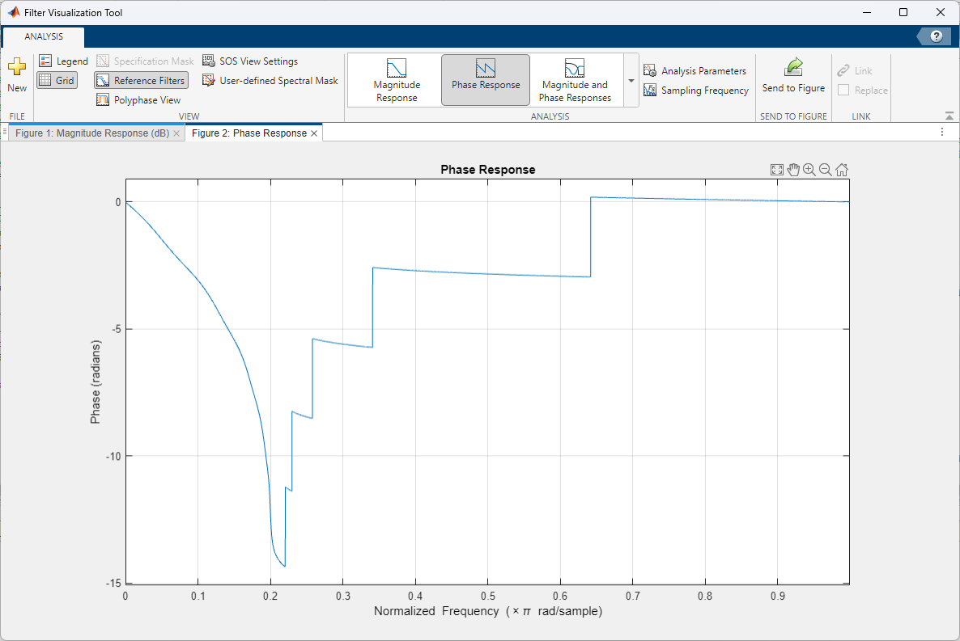
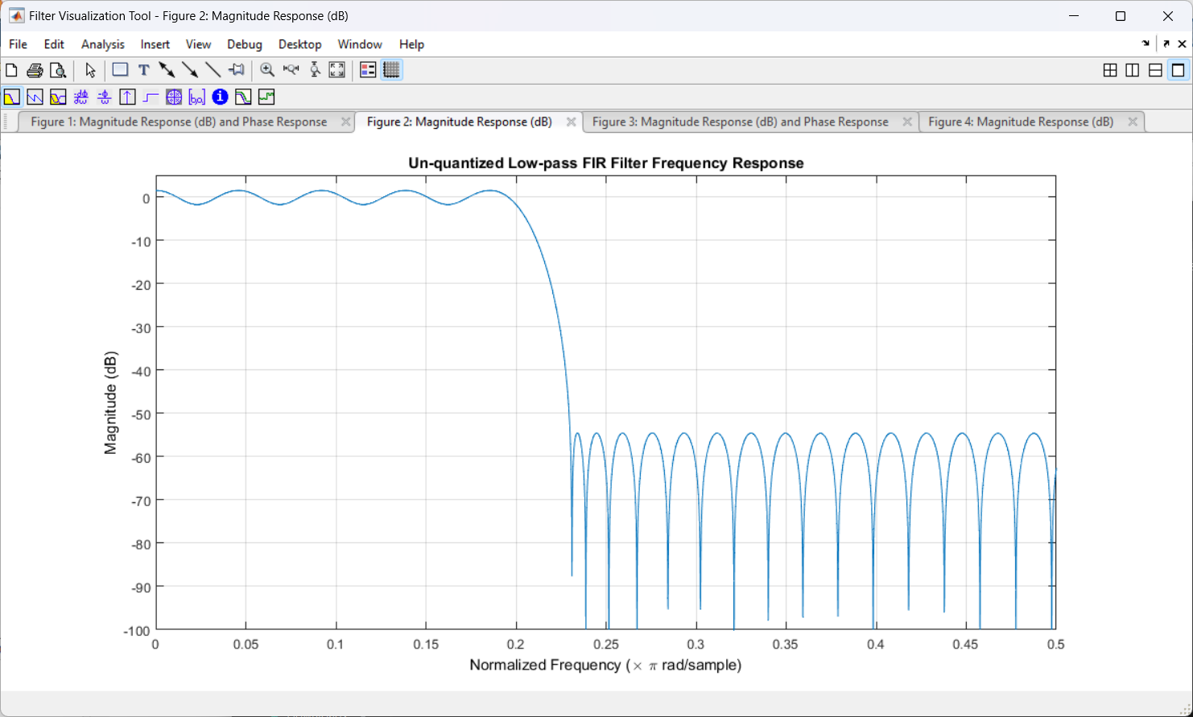
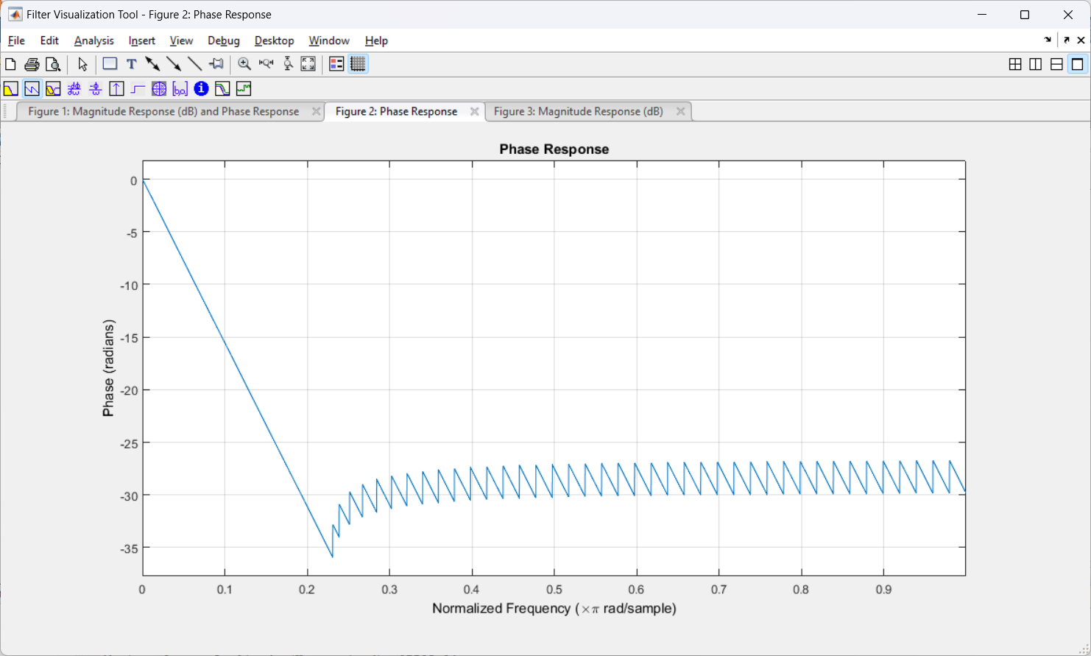
IIR vs. FIR Filter Performance
Disparities in computational efficiency and resource allocation between IIR and FIR filter
Explored the IIR filter’s methodology for direct order calculation, emphasizing its contribution to optimized hardware utilization
Figure 4: FIR unquantized performance
Figure 5: IIR unquantized performance

Slide 8
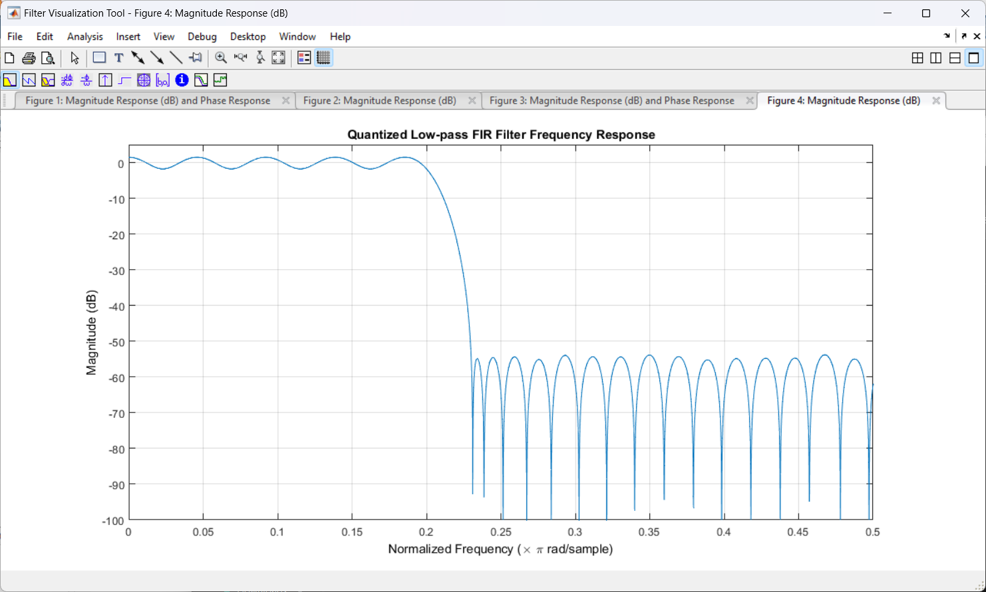
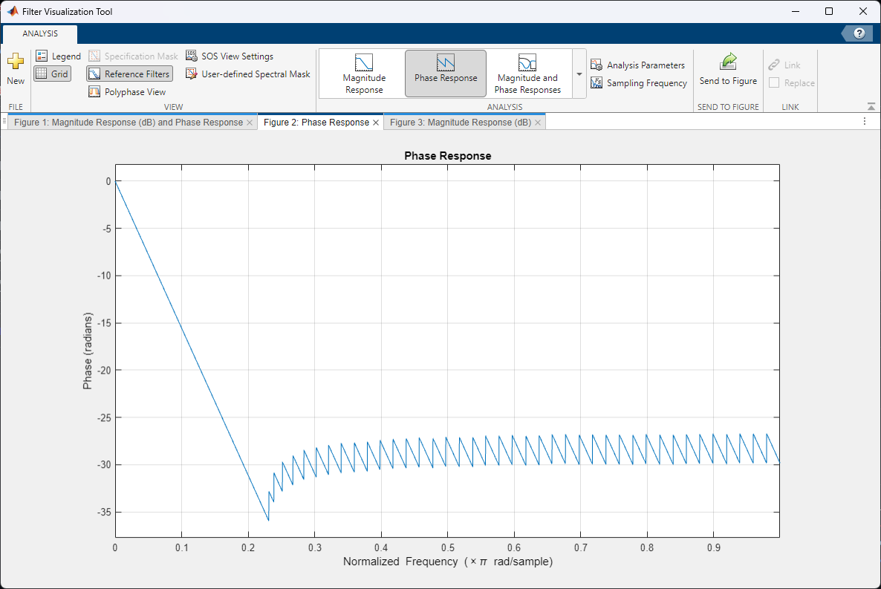
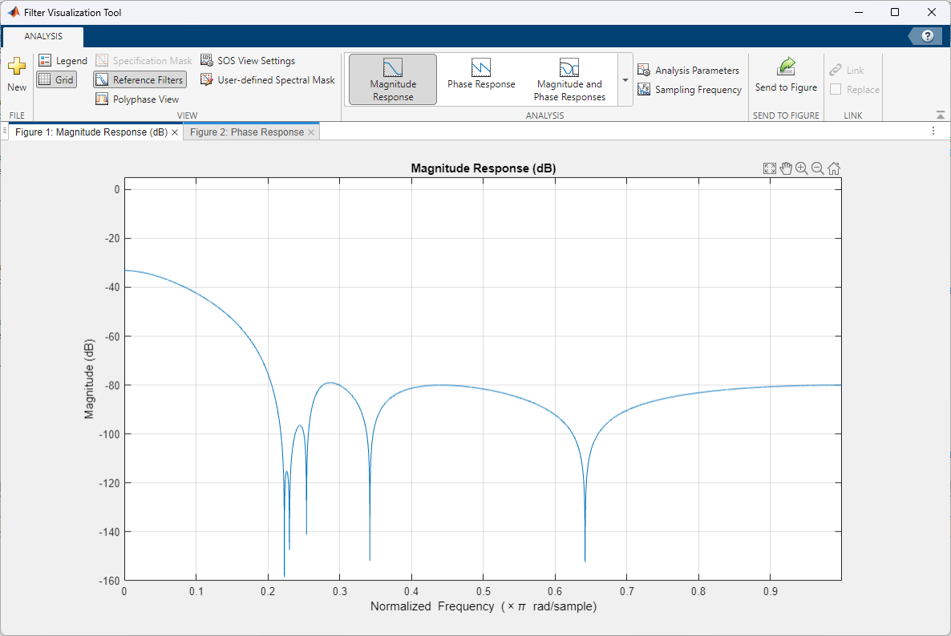
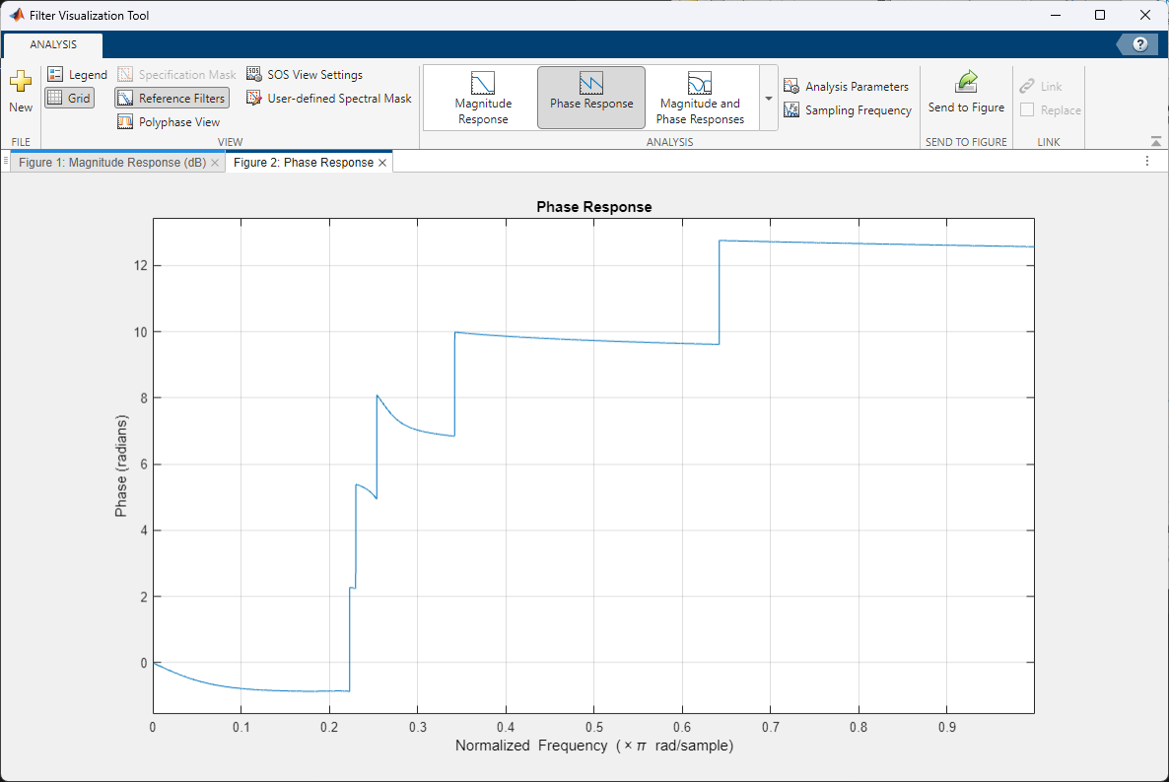
Figure 6: FIR quantized magnitude
Figure 7: FIR quantized phase
Figure 8: IIR quantized magnitude
Figure 9: IIR unquantized phase

Slide 9
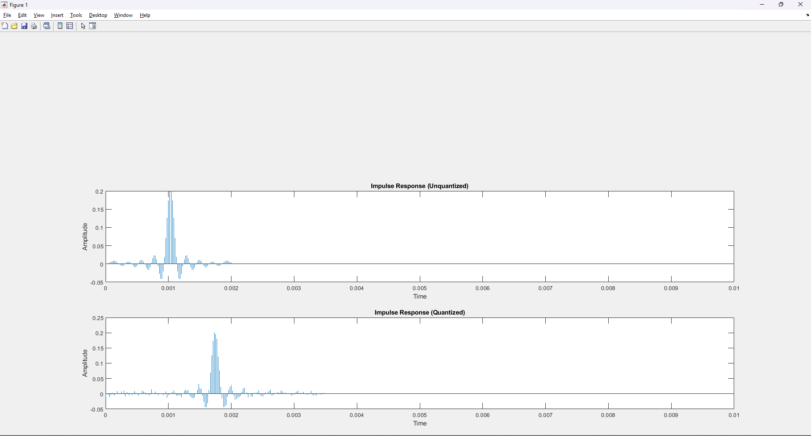
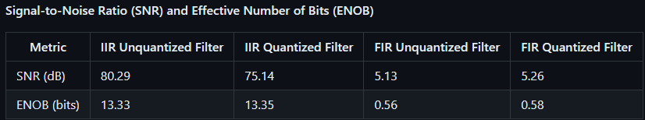
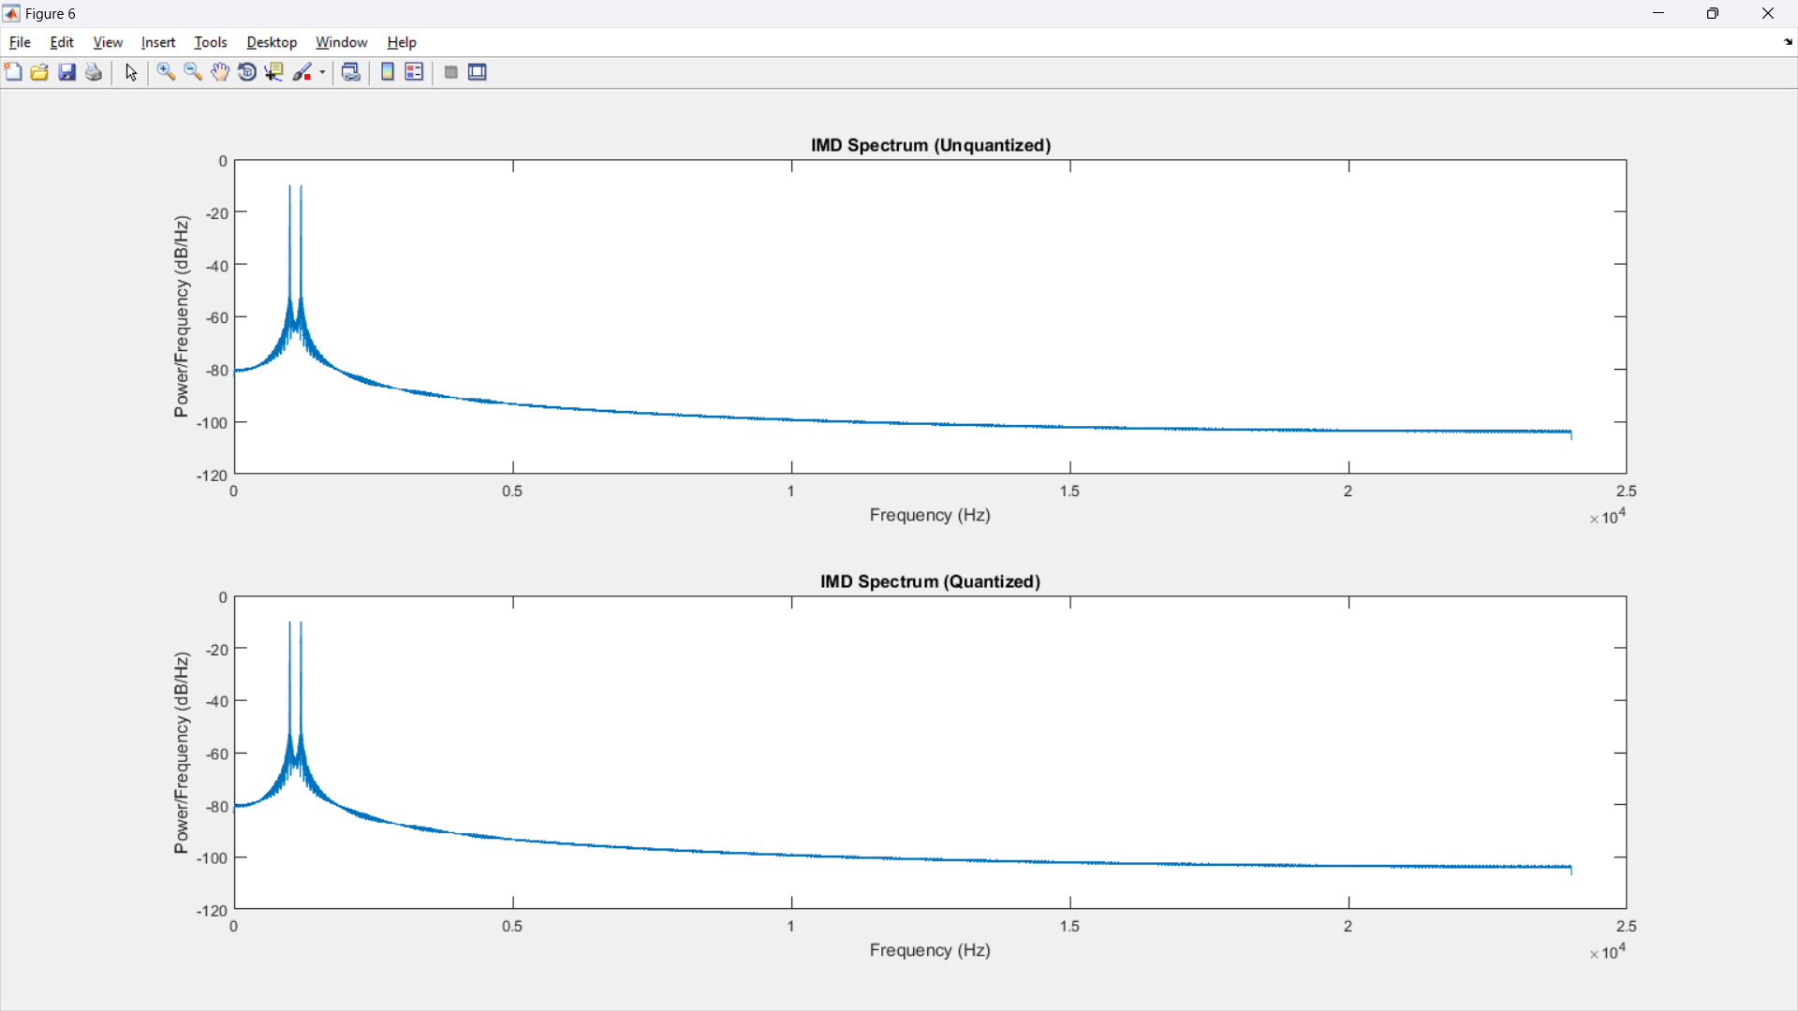
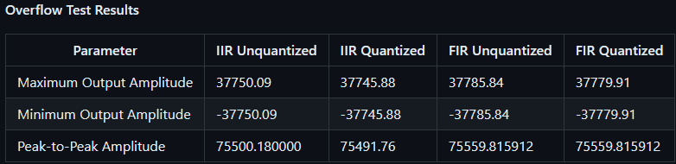
MATLAB Results and Insights
Quantitative metrics such as SNR and ENOB as well as overflow characteristics facilitating a robust comparison of filter performances
Figure 12: Impulse Response Comparison
Figure 10: IIR vs. FIR SNR and ENOB Comparisons
Figure 11: IIR vs. FIR Overflow Comparisons
Figure 13: Intermodulation Distortion (IMD)

Slide 10
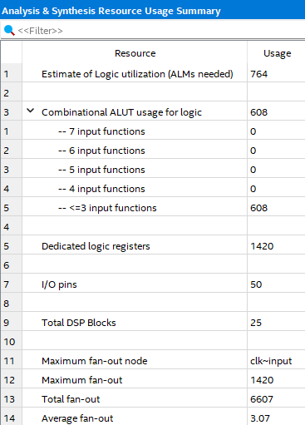
Hardware Performance Metrics
High-speed clock frequency management
FPGA resource allocation and DSP block engagement, highlighting the strategic use of Adaptive Logic Modules (ALMs)
Granular logic utilization breakdown, showcasing the organization of combinational ALUTs and dedicated logic registers for enhanced filter operation
Figure 15: Resource Usage IIR
Figure 14: Clock Frequency Analysis Both FIR and IIR

Slide 11
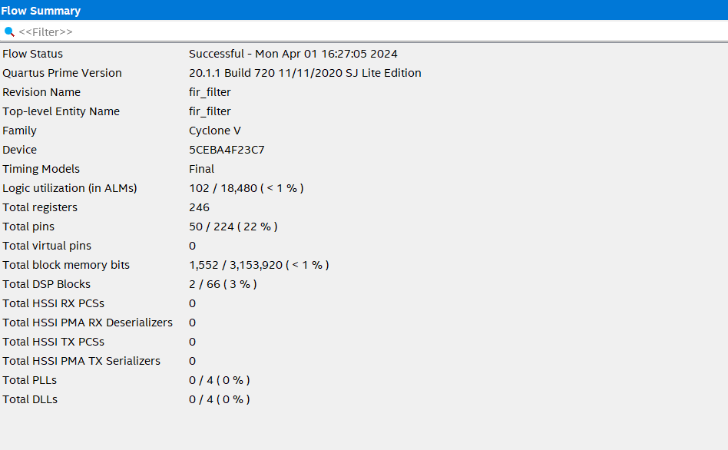
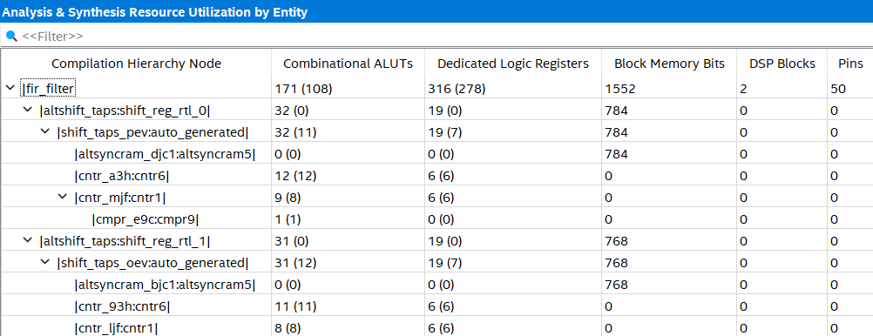
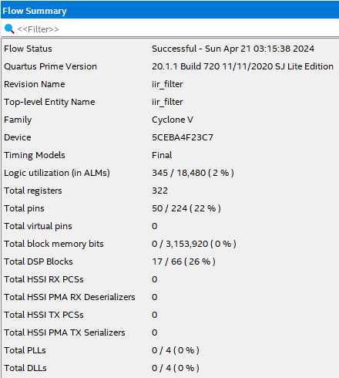
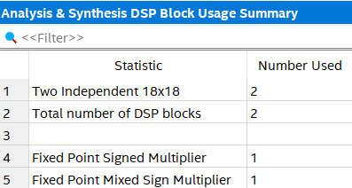
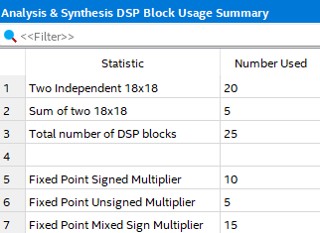
Figure 18: Synthesis Resource Utilization
**FIR
Figure 16: Compilation Report FIR
Figure 20: Compilation Report IIR
Figure 17: DSP Usage FIR
Figure 19: Resource Usage FIR
Figure 21: DSP Usage IIR

Slide 12
Figure 22: Synthesis Resource Utilization IIR

Slide 13
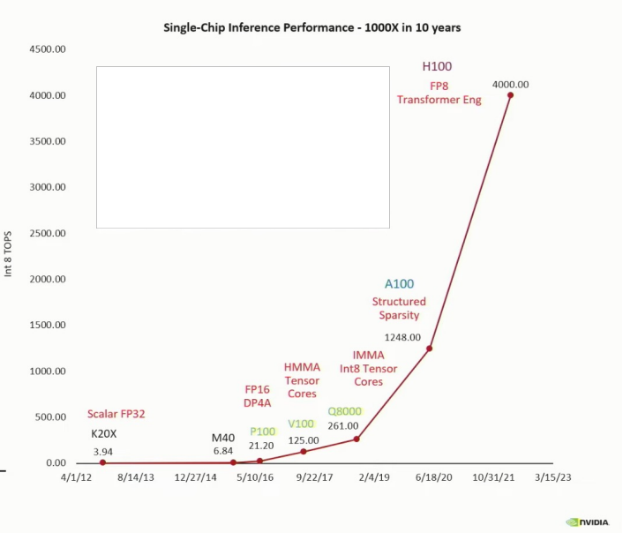
Summary
Project Synthesis: Culminated the design and implementation of an IIR filter by integrating MATLAB's analytical prowess with Verilog's robust synthesis capabilities, achieving the delicate balance between computational efficiency and system stability
Hardware Realization: Translated DSP algorithms into RTL code, successfully demonstrating the project's efficacy in a real-world VLSI environment, while ensuring that system performance was not compromised
Looking Forward: This venture into IIR filter design paves the way for my future projects in DSP, AI and VLSI design, with the aim to continually refine my approaches to complex system implementations
Figure 22: Future Interests

Slide 14
Q&A
Any questions?

Slide 16
Resources
Title Image:
Introduction to IIR Filters - Circuit Cellar
Slide 2:
introduction-iir-filter - MIKROE
Slide 4:
Minimum order for elliptic filters - MATLAB ellipord (mathworks.com)
Slide 6:
Introduction to IIR Filters - Circuit Cellar
Slide 13:
Video Shows How Engineers Fuel Huang's Law | NVIDIA Blogs
GitHub Page:
ADVANCED-VLSI-DESIGN---ECSE-6680/Projects at main · maxdoublee/ADVANCED-VLSI-DESIGN---ECSE-6680 (github.com)

